Slide 1
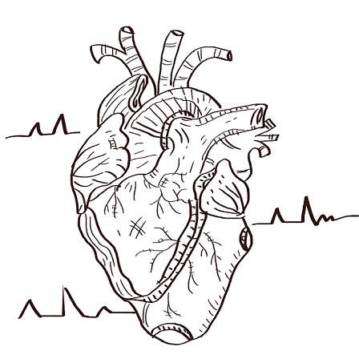
Heart Disease Prediction

Slide 2
Introduction
Several health conditions, your lifestyle, and your age and family history can increase your risk for heart disease. These are called risk factors. About half of all Americans (47%) have at least 1 of 3 key risk factors for heart disease: high blood pressure, high cholesterol, and smoking. Other key indicator like diabetic status, drinking too much alcohol. Detecting and preventing the factors that have the greatest impact on heart disease is very important in healthcare.
Dataset
The dataset come from the Centers for Disease control and prevention (CDC), which conducts annual telephone surveys to gather data on the health status of U.S. residents.
The dataset contains 18 variables and 319795 entries.

Slide 3
Explanation of the features of the dataset
HeartDisease (target) : take value yes or no.
Smoking : Have you smoked at least 100 cigarettes in your entire life? ( The answer Yes or No ).
AlcoholDrinking : Heavy drinkers (adult men having more than 14 drinks per week and adult women having more than 7 drinks per week
Stroke : (Ever told) (you had) a stroke?
PhysicalHealth : Now thinking about your physical health, which includes physical illness and injury, for how many days during the past 30 days was your physical health not good? (0-30 days).
MentalHealth : Thinking about your mental health, for how many days during the past 30 days was your mental health not good? (0-30 days).
DiffWalking : Do you have serious difficulty walking or climbing stairs?
Sex : Are you male or female?
AgeCategory: Fourteen-level age category.
Race : Imputed race/ethnicity value.
Diabetic : (Ever told) (you had) diabetes?
PhysicalActivity : Adults who reported doing physical activity or exercise during the past 30 days other than their regular job.
GenHealth : Would you say that in general your health is...
SleepTime : On average, how many hours of sleep do you get in a 24-hour period?
Asthma : (Ever told) (you had) asthma?
KidneyDisease : Not including kidney stones, bladder infection or incontinence, were you ever told you had kidney disease?
SkinCancer : (Ever told) (you had) skin cancer?

Slide 4
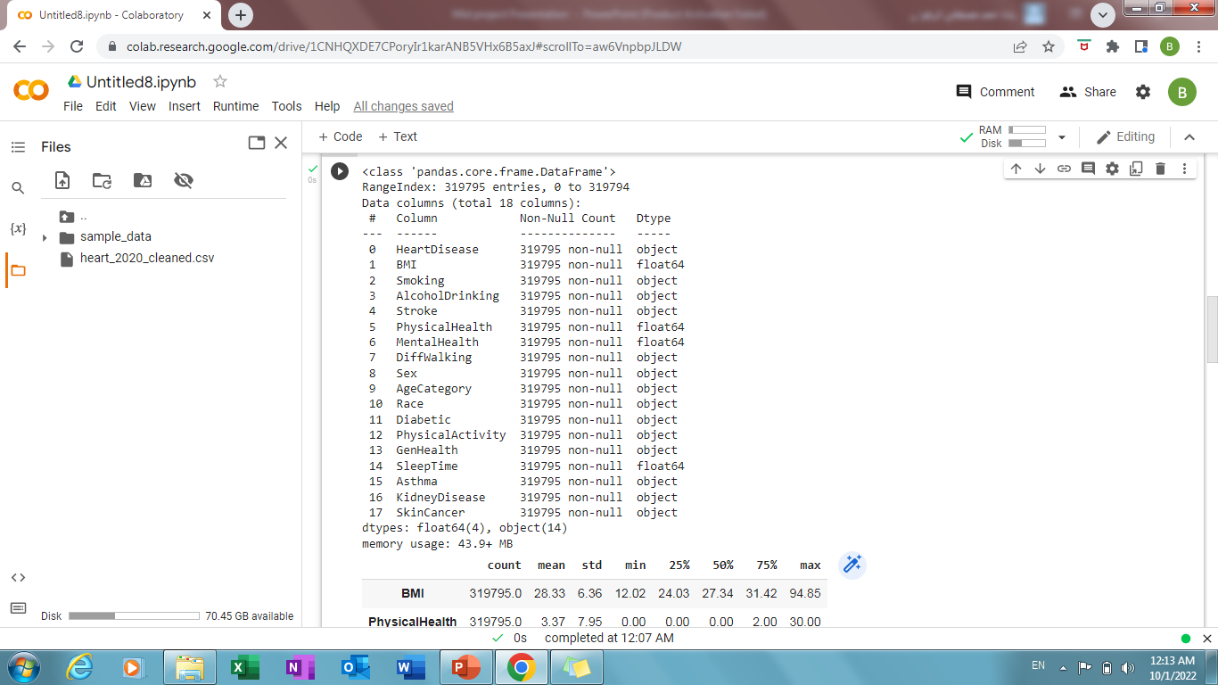
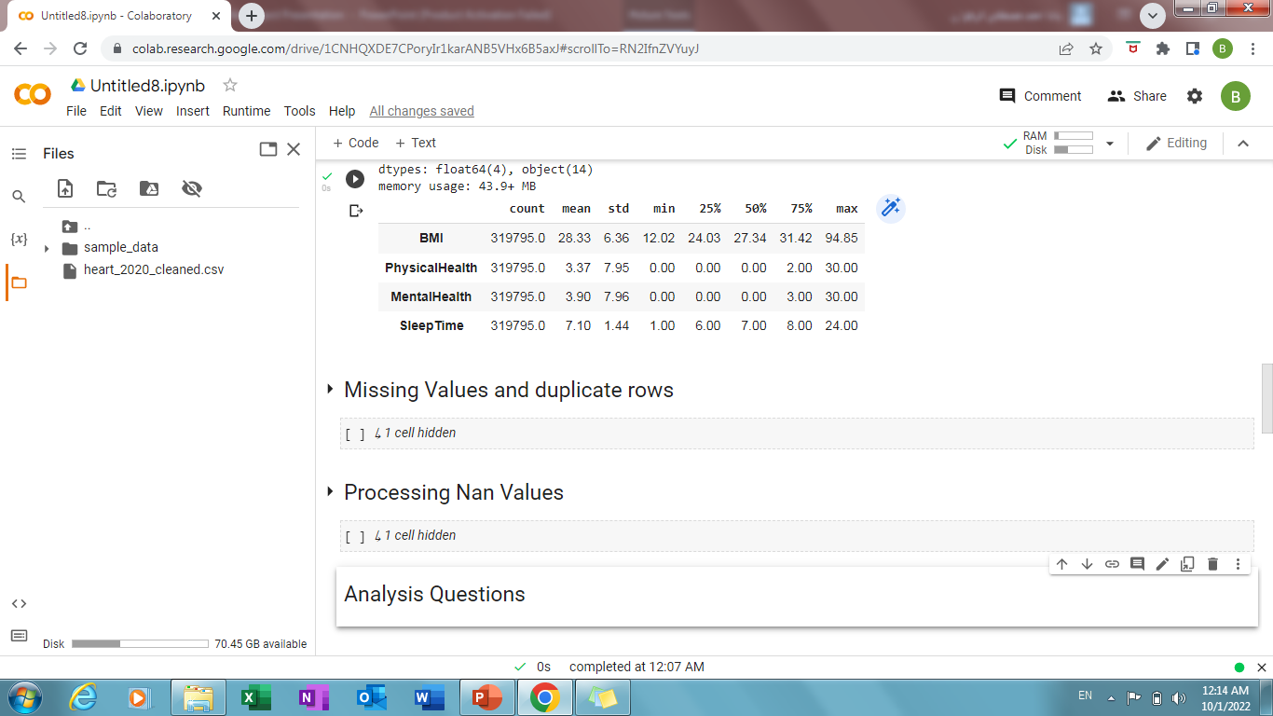
Information for data

Slide 5
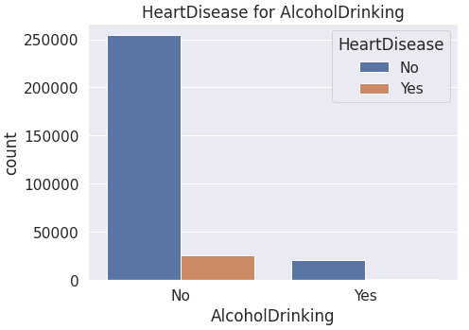
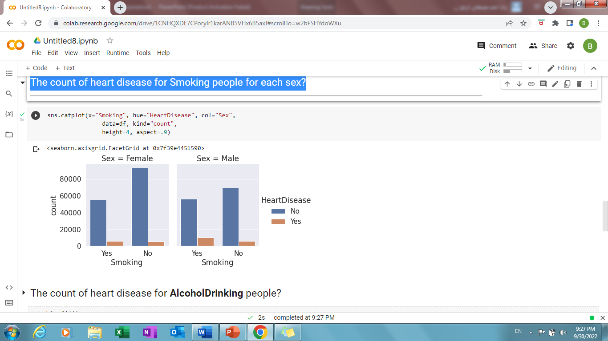
Analysis Questions
1-The count of heart disease for AlcoholDrinking people?
2-The count of heart disease for Smoking people for each sex?

Slide 6
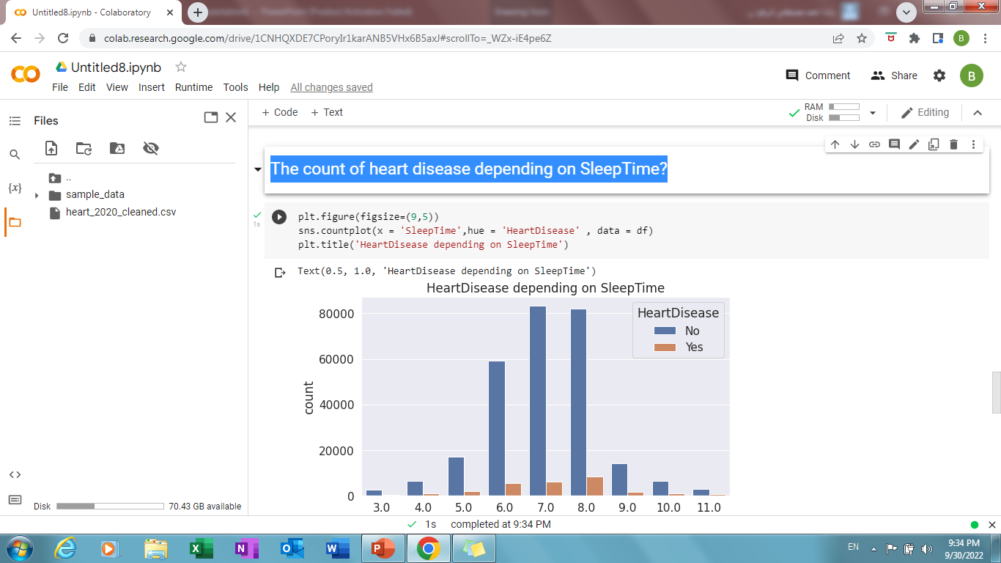
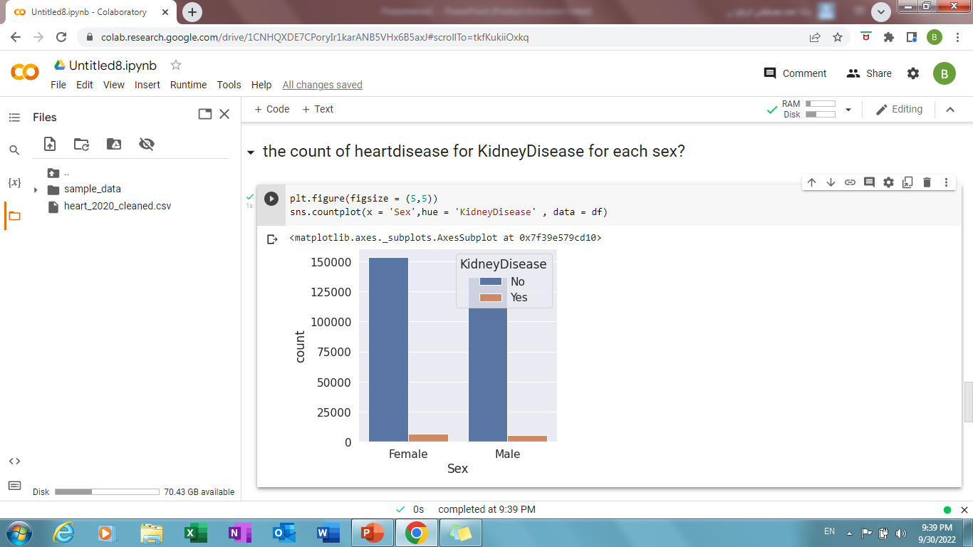
Analysis Questions
3-The count of heart disease depending on SleepTime?
4-The count of heartdisease for KidneyDisease for each sex?

Slide 7
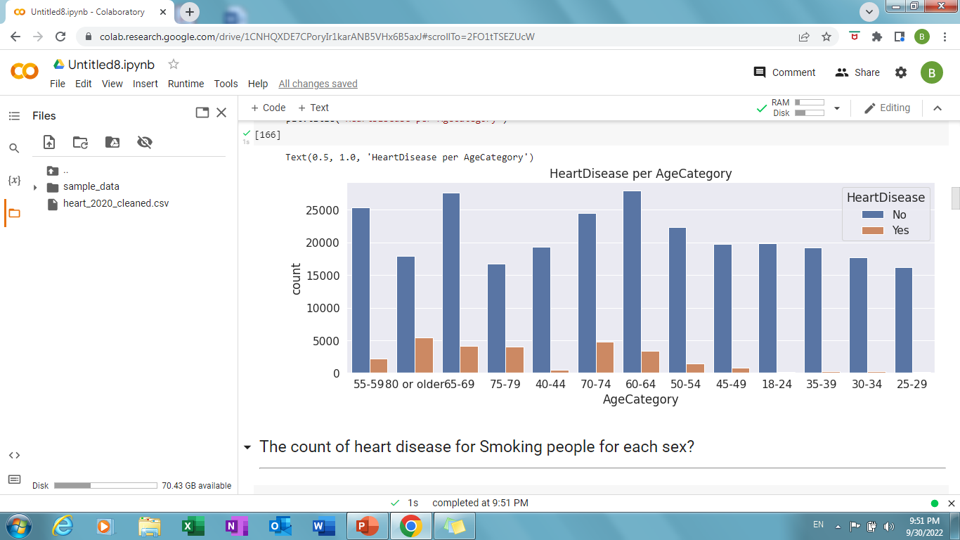
Analysis Questions
5-The count of heart disease for each AgeCategory?

Slide 8
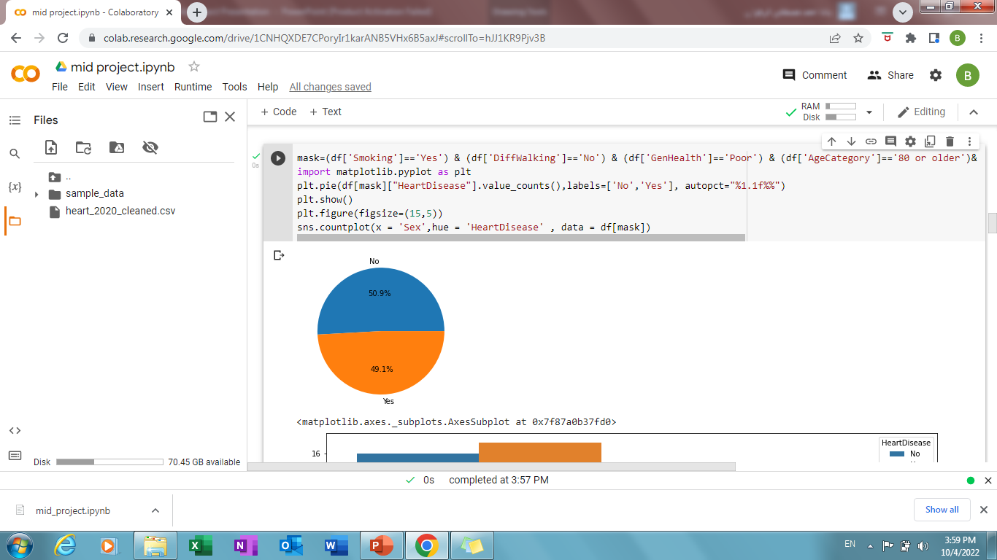
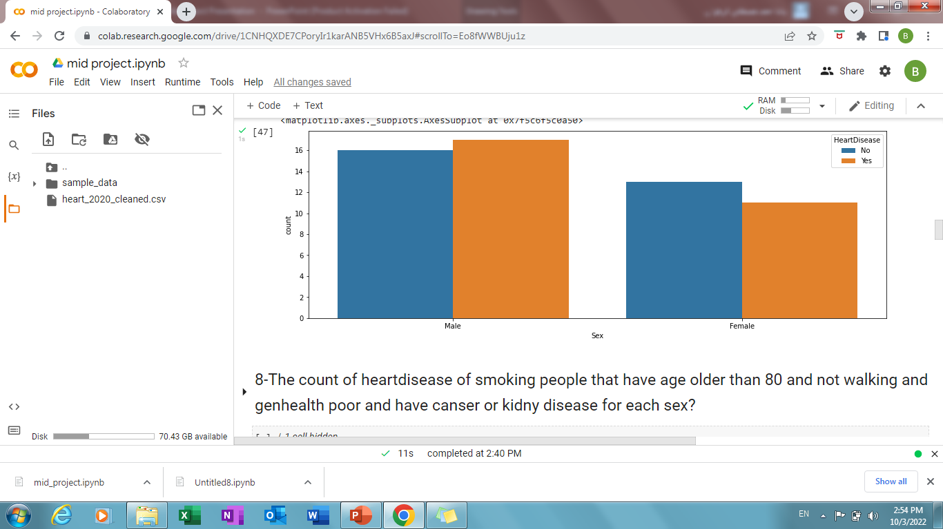
6-The count of heartdisease of smoking people that have age older than 80 and not walking and genhealth poor and have kidney or stroke disease for each sex?
Percentage for all sex

Slide 9
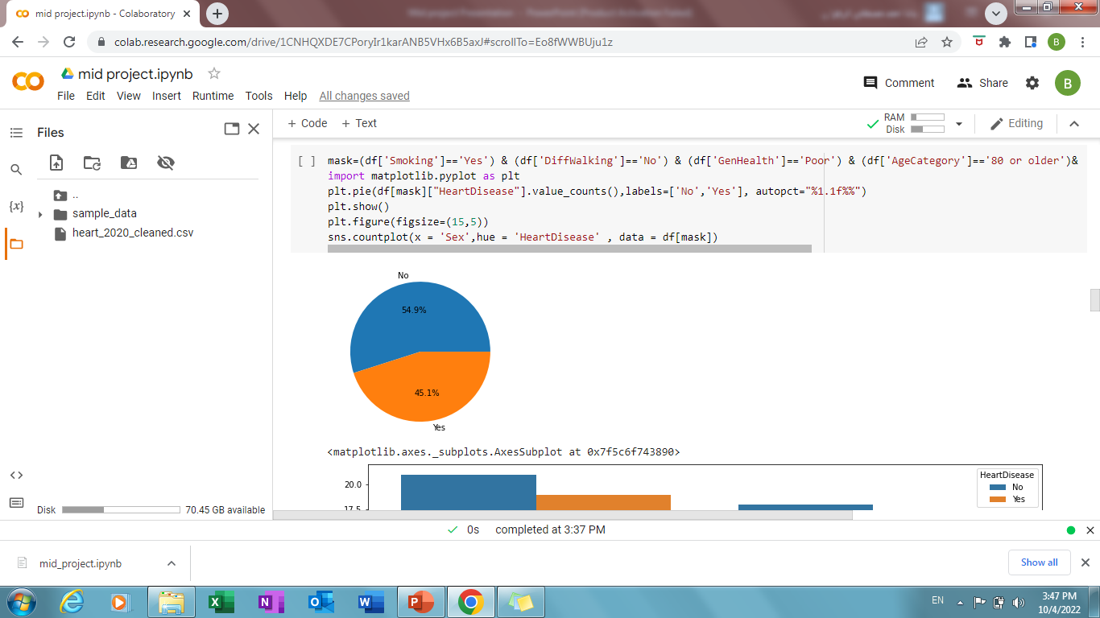
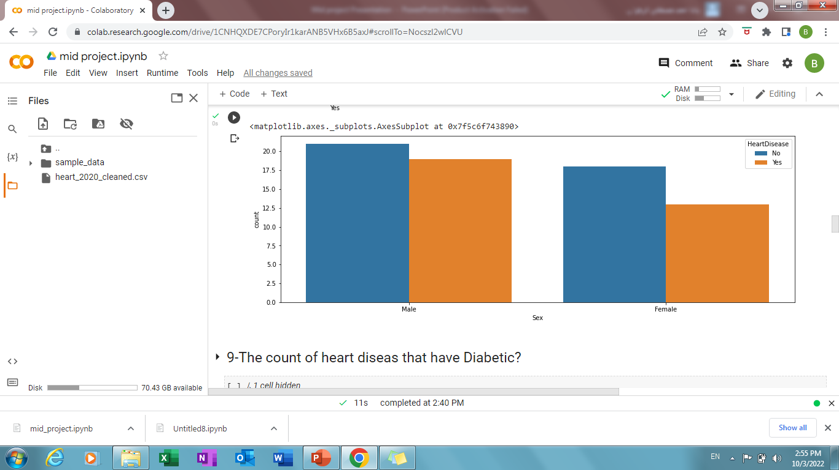
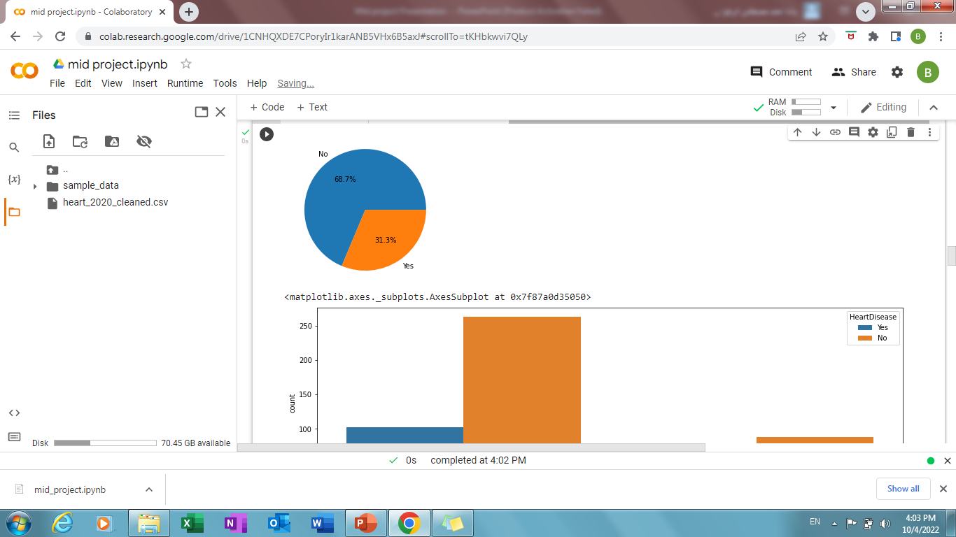
7-The count of heart disease of smoking people that have age older than 80 and not walking and genhealth poor and have kidney or censer disease for each sex?
Smoking &general health poor
Not Smoking &general health good

Slide 10
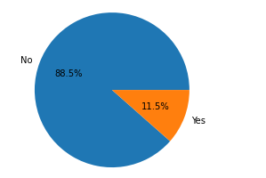
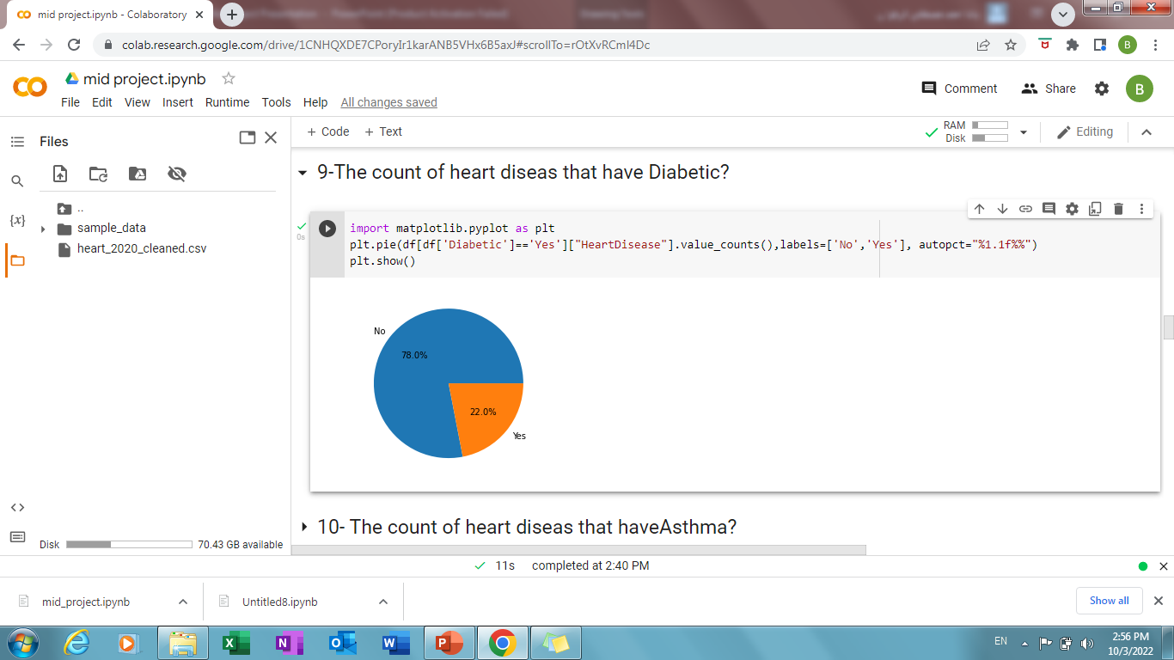
8-The count of heart disease that have Diabetic?
9-The count of heart disease that have Asthma?

Slide 11
Decision
Through the analysis of data, we found that the smoking people of age older than 80 and have diseses like kidney , canser and stoke and the general health is poor and they do not make any physical health or walking are the most people that have heart disese. so we make a Awareness for those people and another that not have any diseses to take off smoking and make physical activity and walking to preserve of a good health.

Slide 12
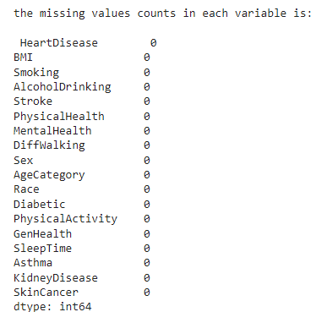
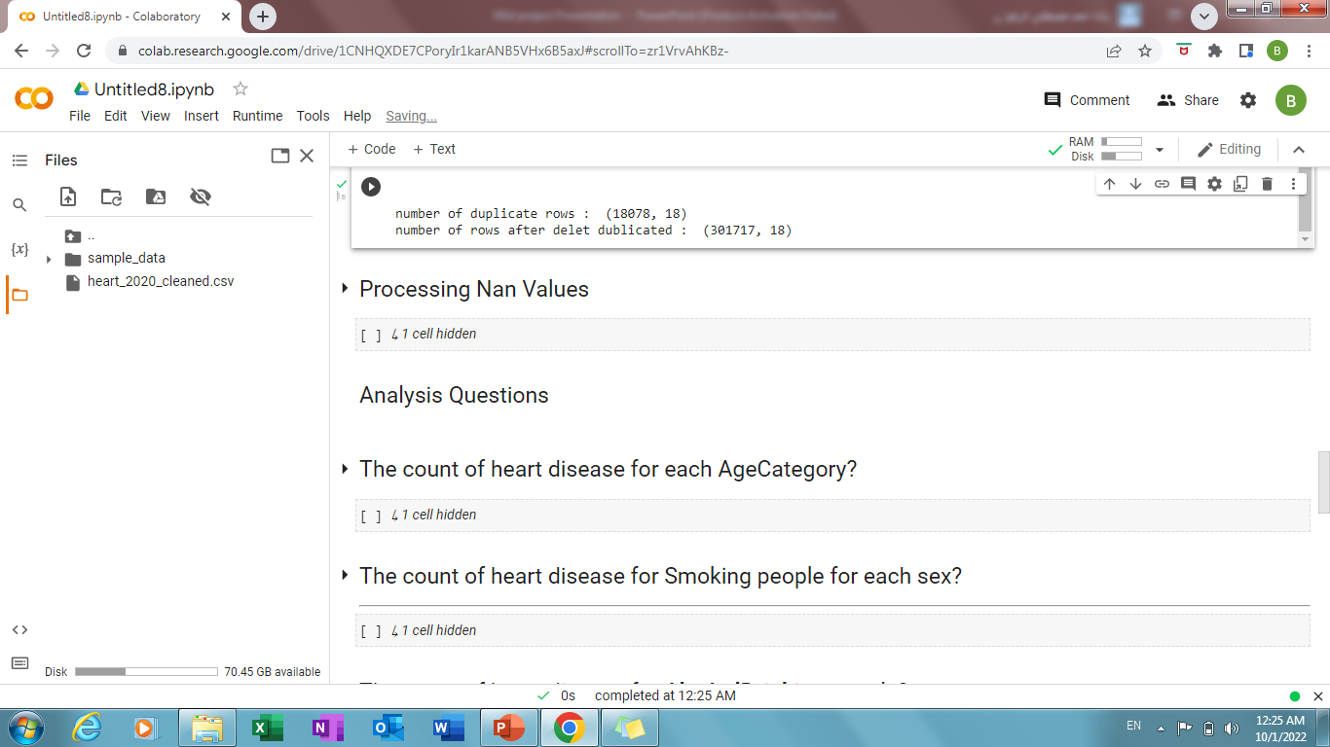
Processing
1-Missing values and Duplicated rows
Duplicated rows

Slide 13
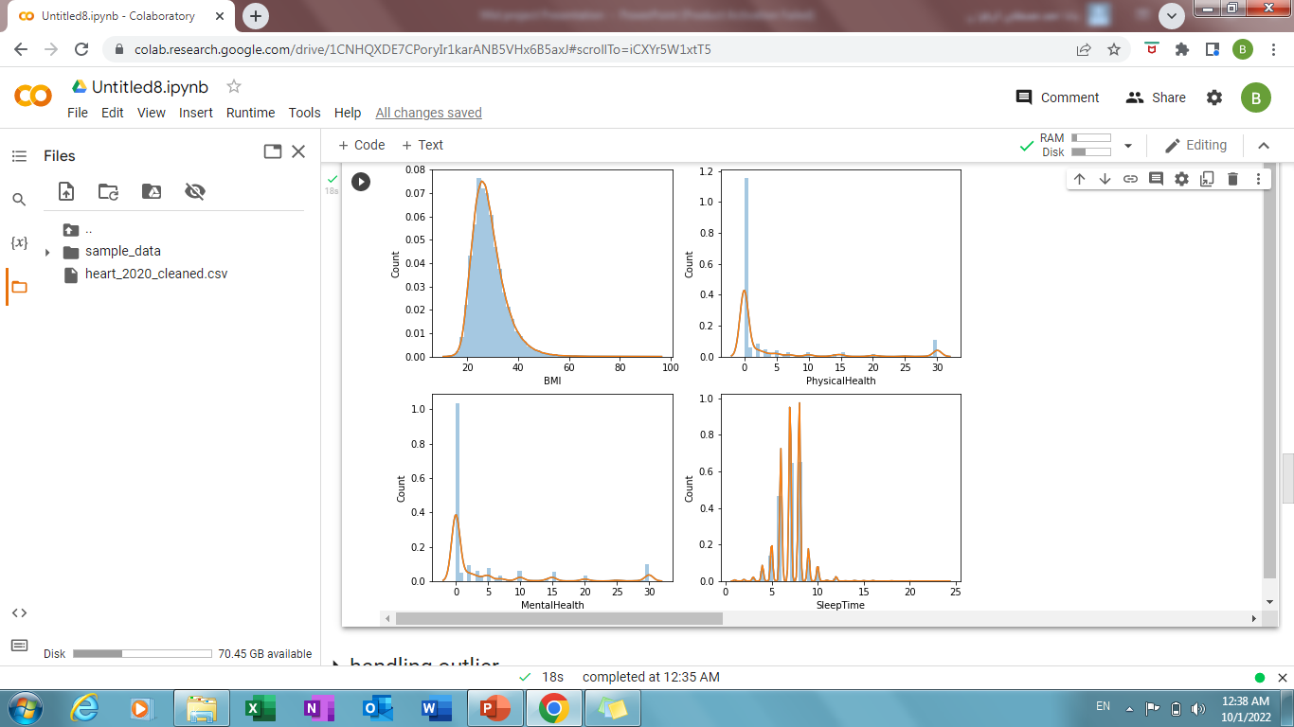
2-Numerical data distribution
Num_col=[BMI, PhysicalHealth, MentalHealth, SleepTime]

Slide 14
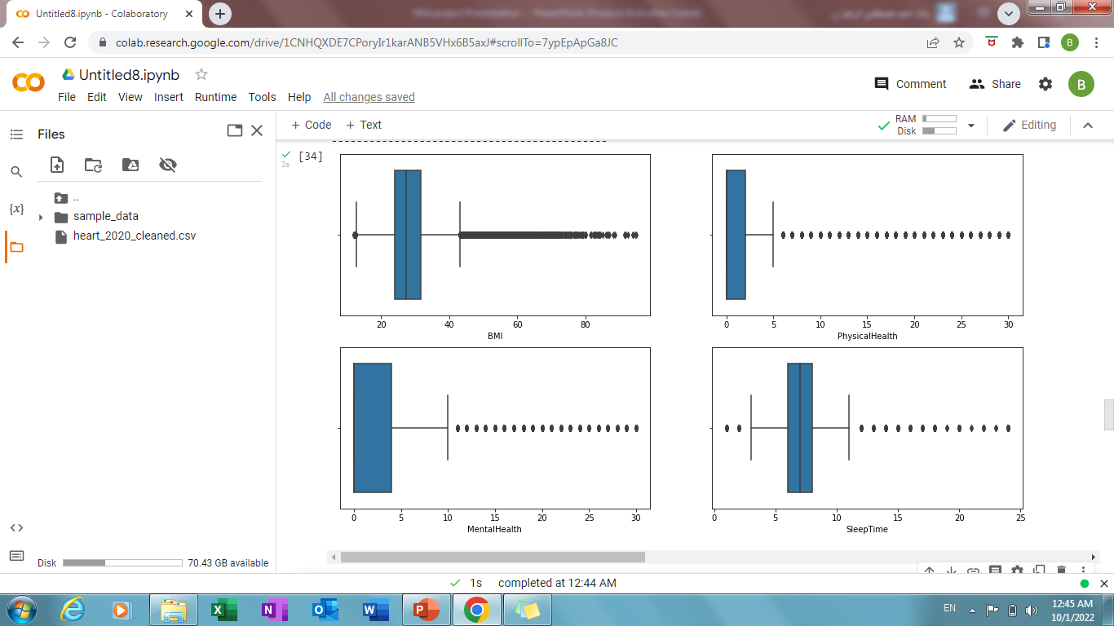
3-Handling outlier
the number of outliers: 79186

Slide 15
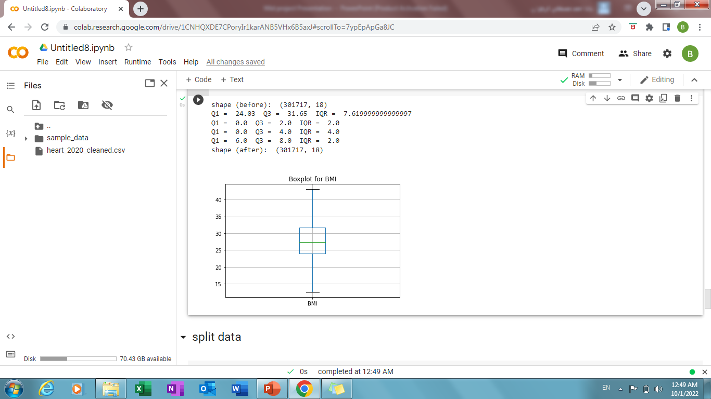
3-Handling outlier
Num_col=[BMI, PhysicalHealth, MentalHealth, SleepTime]

Slide 16
4-Handling categorical
df['GenHealth'].map({'Excellent':5,'Very good':4,'Good':3,'Fair':2,'Poor':1})
df['HeartDisease'].map({'Yes':1,'No':0})
df['AgeCategory']=df['AgeCategory'].map({'18-24':18,'25-29':25,'30-34':30,'35-39':35,'40-44':40,'45-49':45,'50-54':50,'55-59':55,'60-64':60,'65-69':65,'70-74':70,'75-79':75,'80 or older':80})
df = pd.get_dummies(data=df,drop_first=True)

Slide 17
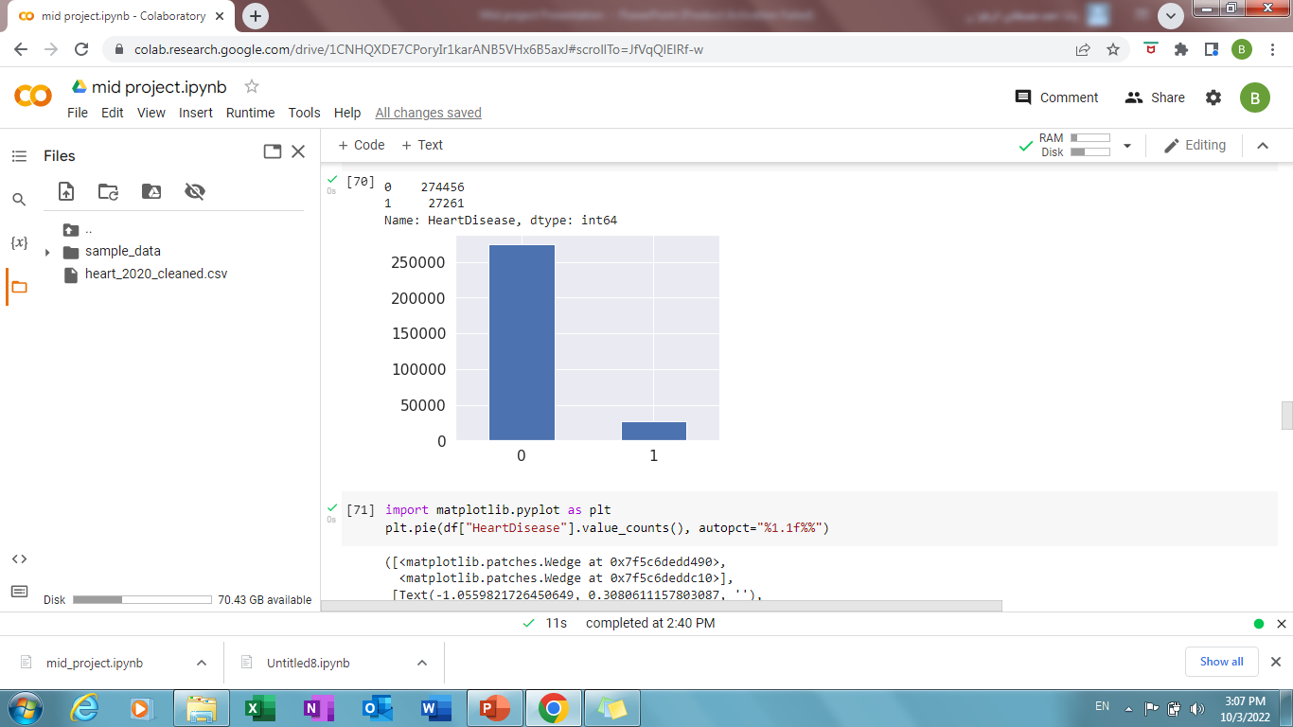
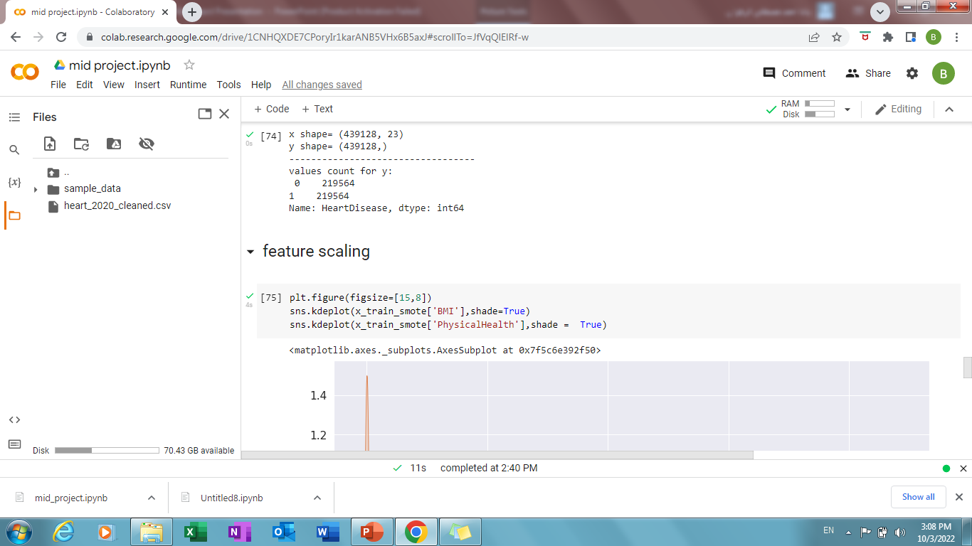
Split data and handle imbalanced

Slide 18
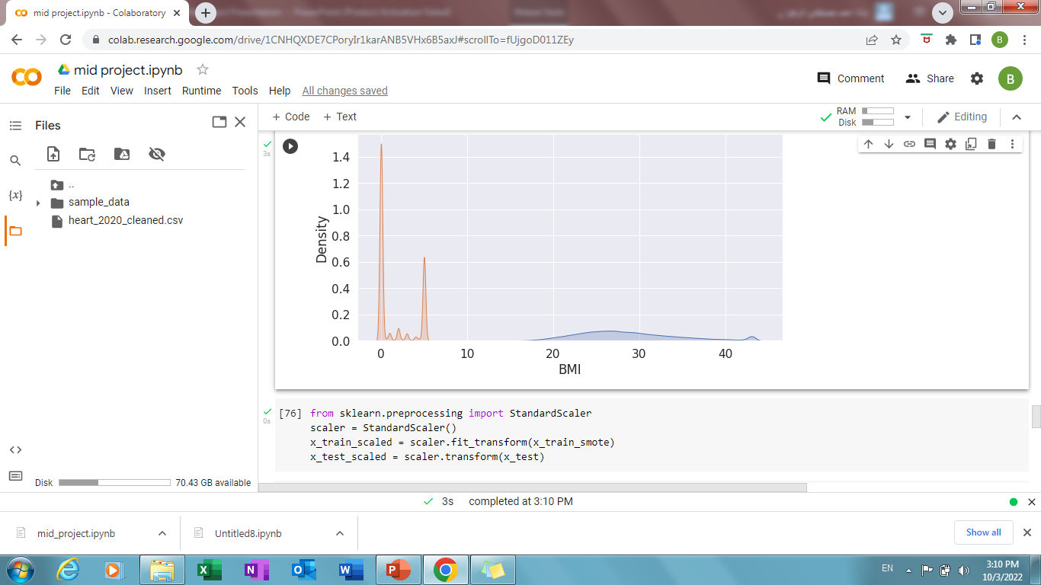
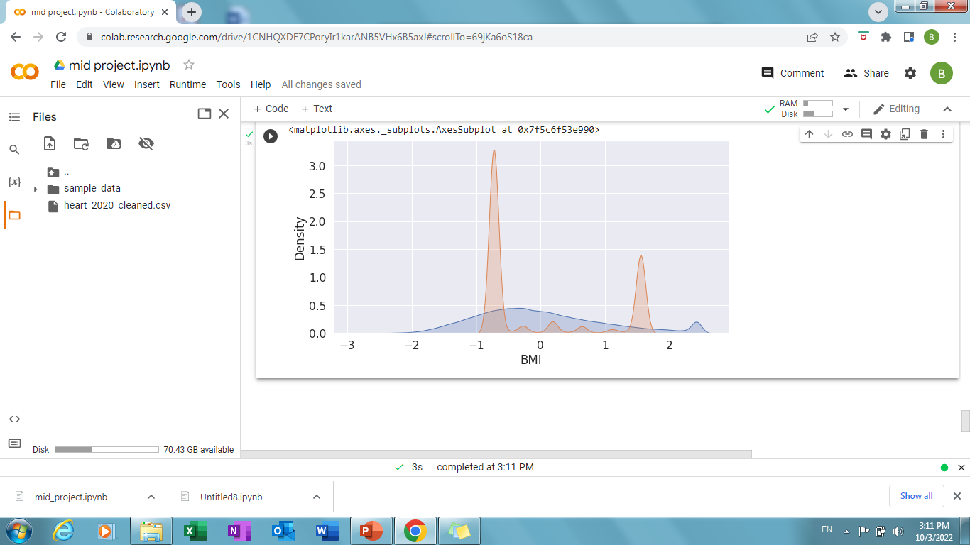
Feature scaling using standerdscaler
PhysicalHealth
before
after

